Slide 1

西门子Mentor DRS360 AD LoLa介绍1 中国区ABU工程技术中心-侯勇
Realize innovation.
Restricted © Mentor – A Siemens Business 2019

Slide 2
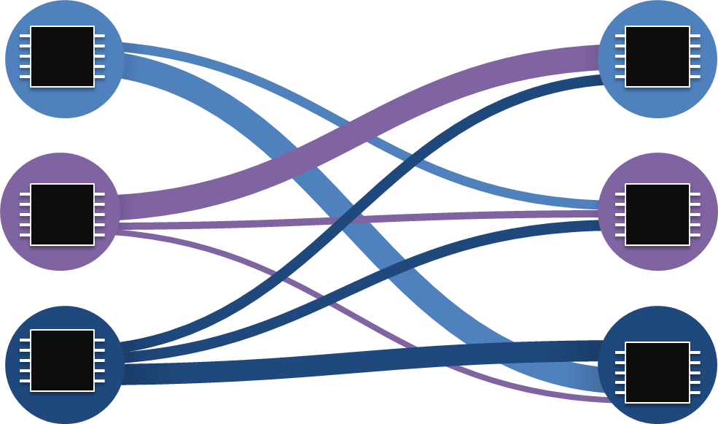
DRS360™ 四大IP 之： LoLa低延迟数据处理框架
LoLa低延迟数据通讯框架
LoLa (Low Latency framework)

Slide 3
DRS360™四大IP 之：LoLa - 软件架构图
LoLa Build
Framework System Description Language
LoLa Pkg A
LoLa Pkg B
LoLa Pkg Z
Component A
Component B
…
Component Z
Algorithm source
Algorithm source
Algorithm source
User Space
FTDL
FCDL
FTDL
FCDL
FTDL
FCDL
…
LoLa Code Generator
Cmp A Interface
Cmp B Interface
Cmp Z Interface
Generated Code
System Runtime Instance
System Runtime Instance
LoLa core runtime
LoLa transport
LoLa core runtime
Middle ware
Lola RTOS Abstraction
LoLa POSIX Abstraction
Real Time OS
Linux
OS
…
CPU1
CPU2
FPGA IP 1
FPGA IP N
CPU3
CPU4
GPU
HW

Slide 4
DRS360™四大IP 之：LoLa：自动生成代码 Auto generated Code
自动生成代码 Code generator：帮助用户快速生成代码，用户专注于自己算法实现
特点一
打包和集成
特点三
用户算法实现
通过FPKG(Framework Package descriptor)可以把每个应用模块打包，以便生成lib，方便集成
LoLa 自动生成的代码已经包含message transport等基础功能，用户只需要在在这个shell下专注于自己的算法实现。
Define system by high level Language
Package components
LoLa building environment
Component implementation
高级描述语言
编译环境
利用高级描述语言来定义用户特定的系统。
LoLa Domain Specific Language is an essential part of the framework. It allows user toexpress his intentions at a high level and generate C/C++14 code out of it. The generatedcode contains headers and source files.
Support namespacing in high level language
Support “Msg ref” instead of msg files in ROS
Default initialization of variables within the FTDL
Ship convenience macros to generate code from high level domain language
Create the build targets
Facilitate integration of different components through the encapsulation of include and link paths within the CMake targets.
特点二
特点四

Slide 5
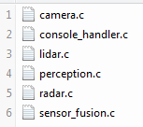
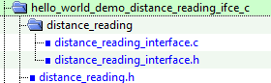
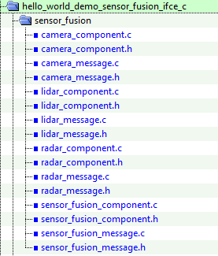
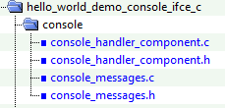
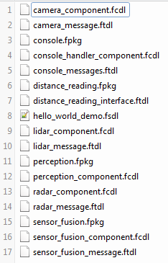
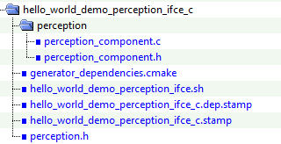
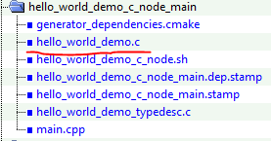
LoLa: Hello world Node: Auto generate code-1
Source files
Interface files
Generate interface packages(*ifce) by *.fpkg
Generate node app
using hello_world_demo.fsdl

Slide 6
LoLa: Hello world Node: Auto generate code-2
Source files
$:../drs360_all/application/lola_demo/demos/CMakeLists.txt
################################### packages ########################
lola_generate_interface(SOURCE hello_world_demo/interface/distance_reading.fpkg
TARGET_LIB hello_world_demo_distance_reading_ifce)
lola_generate_interface(SOURCE hello_world_demo/interface/console.fpkg
TARGET_LIB hello_world_demo_console_ifce)
lola_generate_interface(SOURCE hello_world_demo/interface/sensor_fusion.fpkg
TARGET_LIB hello_world_demo_sensor_fusion_ifce
DEPENDS
hello_world_demo_console_ifce
hello_world_demo_distance_reading_ifce
bsp_trace_ifce)
lola_generate_interface(SOURCE hello_world_demo/interface/perception.fpkg
TARGET_LIB hello_world_demo_perception_ifce
DEPENDS
hello_world_demo_sensor_fusion_ifce)
################################# hello_world C demo ###################
… …
drs360_add_node_app(hello_world_demo_c
FSDL hello_world_demo/interface/hello_world_demo.fsdl
ONLY_C_LIB
IFCE_DEPENDS
hello_world_demo_perception_ifce
hello_world_demo_sensor_fusion_ifce
hello_world_demo_console_ifce
bsp_trace_ifce
……
Interface files

Slide 7
convert

Slide 8
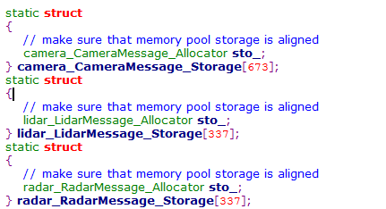
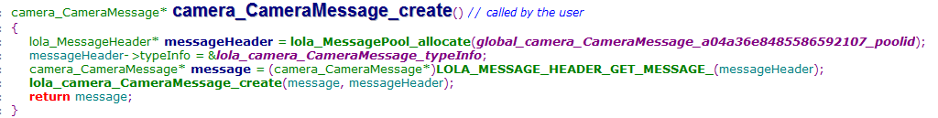
LoLa: LoLaMessage: message pool init and allocate-1

Slide 9
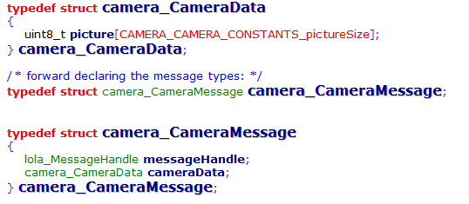
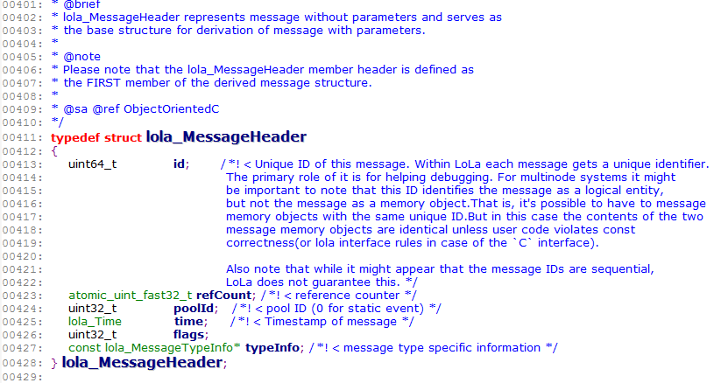
LoLa: LoLaMessage: message structure
messagegHeader
LoLaMessage : Message Header + payload
E.g.:Camera message (AutoGened from camera_message.ftdl )
Message data

Slide 10
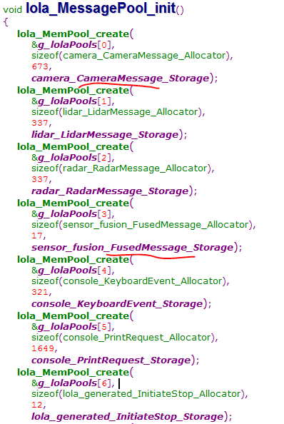
LoLa: Hello World: lola_init()

Slide 11
LoLa: Hello World: lola_run()

Slide 12
LoLa: Hello World - Startup
One Process (node) including
Msg Dispatcher thread,
Console thread,
System Reactor thread

Slide 13
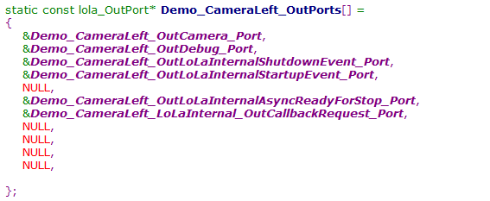
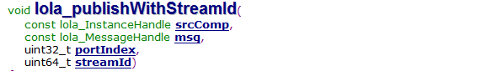
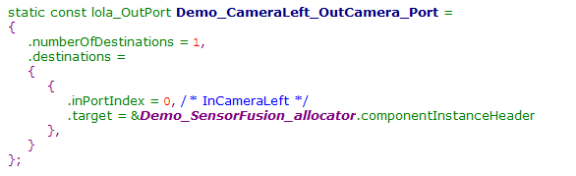
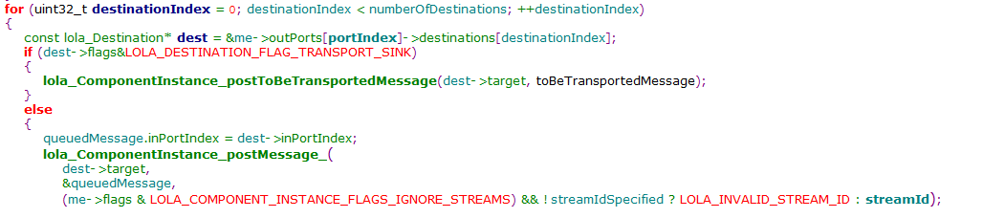
LoLa Message: send message: outPorts
Using outPorts index, route to the proper component handler
User defined port

Slide 14
LoLa Message: Handle message: inPorts
Route to the proper message handler using inPorts
User defined port
Global port

Slide 15
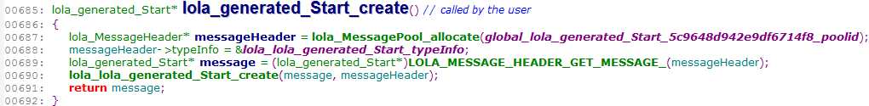
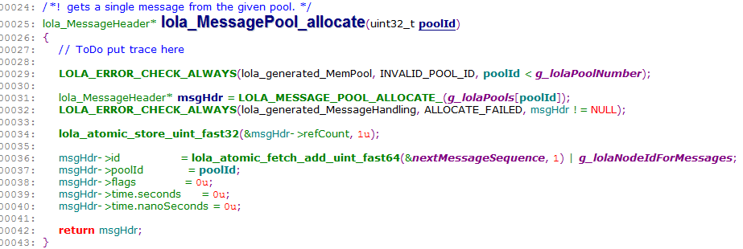
LoLa Message data structure-2
Pool ID is generated in hello_world_demo.c
Initialize the msgId

